Slide 1
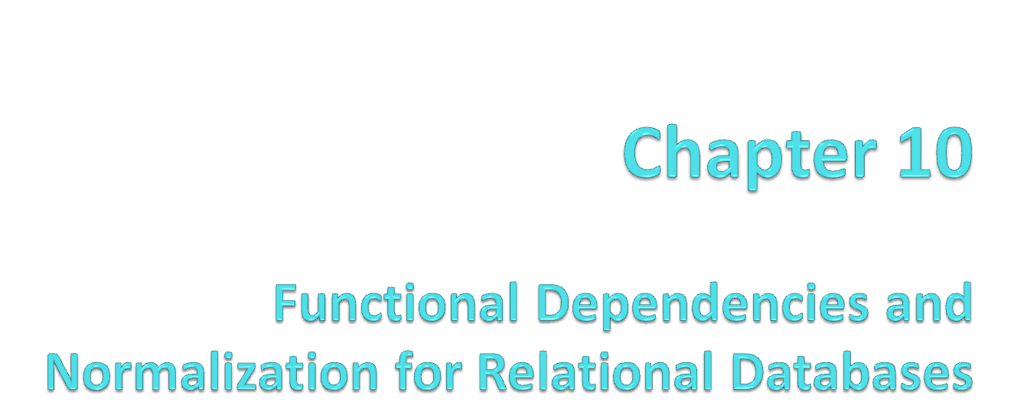
Notes:
115/11/07

Slide 2
Chapter Outline
1 Informal Design Guidelines for Relational Databases
1.1Semantics of the Relation Attributes
1.2 Redundant Information in Tuples and Update Anomalies
1.3 Null Values in Tuples
1.4 Spurious Tuples
2 Functional Dependencies (FDs)
2.1 Definition of FD
2.2 Inference Rules for FDs
2.3 Equivalence of Sets of FDs
2.4 Minimal Sets of FDs

Slide 3
Chapter Outline(contd.)
3 Normal Forms Based on Primary Keys
3.1 Normalization of Relations
3.2 Practical Use of Normal Forms
3.3 Definitions of Keys and Attributes Participating in Keys
3.4 First Normal Form
3.5 Second Normal Form
3.6 Third Normal Form
4 General Normal Form Definitions (For Multiple Keys)
5 BCNF (Boyce-Codd Normal Form)

Slide 4
1 Informal Design Guidelines for Relational Databases (1)
What is relational database design?
The grouping of attributes to form "good" relation schemas
Two levels of relation schemas
  The logical "user view" level
  The storage "base relation" level
Design is concerned mainly with base relations
What are the criteria for "good" base relations?

Slide 5
Informal Design Guidelines for Relational Databases (2)
We first discuss informal guidelines for good relational design
Then we discuss formal concepts of functional dependencies and normal forms
- 1NF (First Normal Form)
- 2NF (Second Normal Form)
- 3NF (Third Normal Form)
- BCNF (Boyce-Codd Normal Form)
Additional types of dependencies, further normal forms, relational design algorithms by synthesis are discussed in Chapter 11

Slide 6
1.1 Semantics of the Relation Attributes
GUIDELINE 1: Informally, each tuple in a relation should represent one entity or relationship instance. (Applies to individual relations and their attributes).
Attributes of different entities (EMPLOYEEs, DEPARTMENTs, PROJECTs) should not be mixed in the same relation
Only foreign keys should be used to refer to other entities
Entity and relationship attributes should be kept apart as much as possible.
Bottom Line: Design a schema that can be explained easily relation by relation. The semantics of attributes should be easy to interpret.

Slide 7
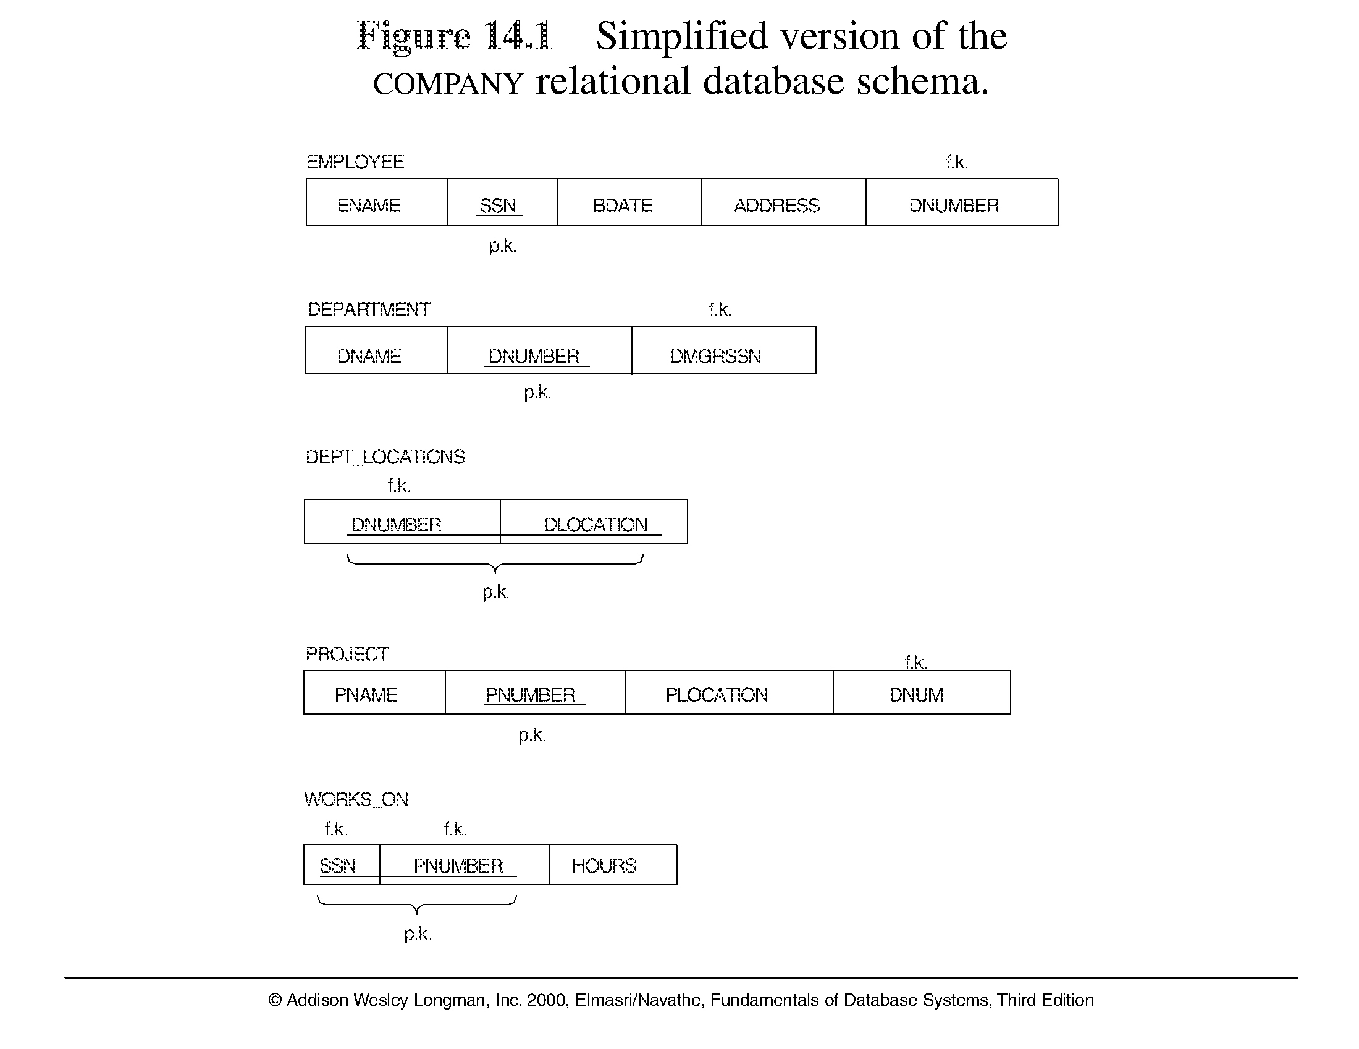
Figure 10.1 A simplified COMPANY relational database schema

Slide 8
1.2 Redundant Information in Tuples and Update Anomalies
Mixing attributes of multiple entities may cause problems
Information is stored redundantly wasting storage
Problems with update anomalies
  Insertion anomalies
  Deletion anomalies
  Modification anomalies

Slide 9
EXAMPLE OF AN UPDATE ANOMALY (1)
Consider the relation:
EMP_PROJ ( Emp#, Proj#, Ename, Pname, No_hours)
Update Anomaly: Changing the name of project number P1 from “Billing” to “Customer-Accounting” may cause this update to be made for all 100 employees working on project P1.

Slide 10
EXAMPLE OF AN UPDATE ANOMALY (2)
Insert Anomaly: Cannot insert a project unless an employee is assigned to .
Inversely - Cannot insert an employee unless an he/she is assigned to a project.
Delete Anomaly: When a project is deleted, it will result in deleting all the employees who work on that project. Alternately, if an employee is the sole employee on a project, deleting that employee would result in deleting the corresponding project.

Slide 11
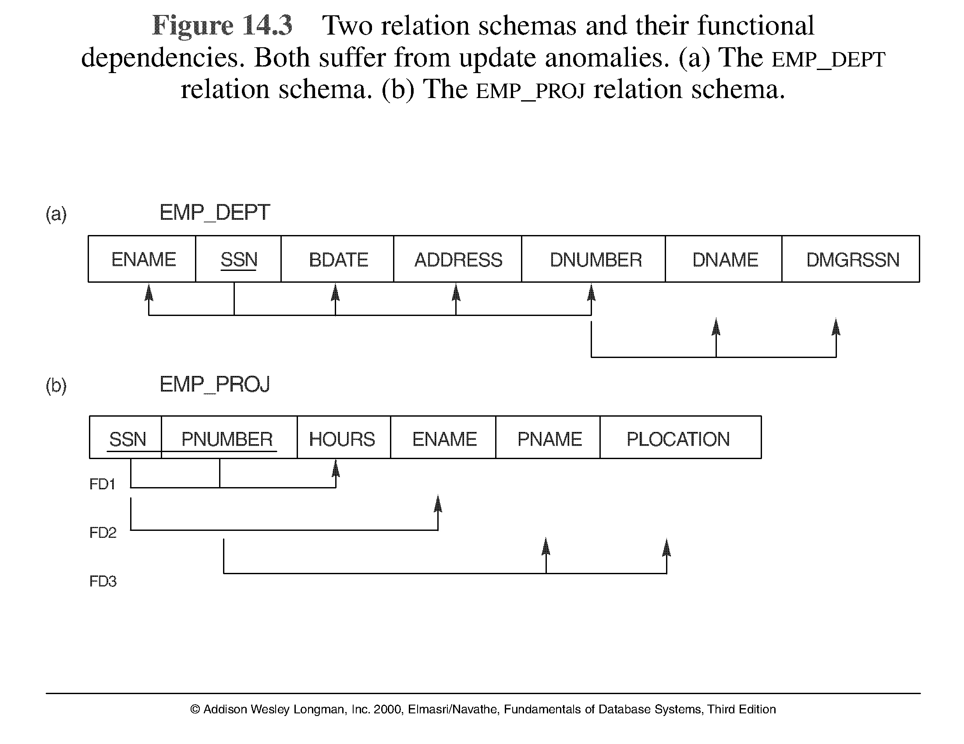
Figure 10.3 Two relation schemas suffering from update anomalies

Slide 12
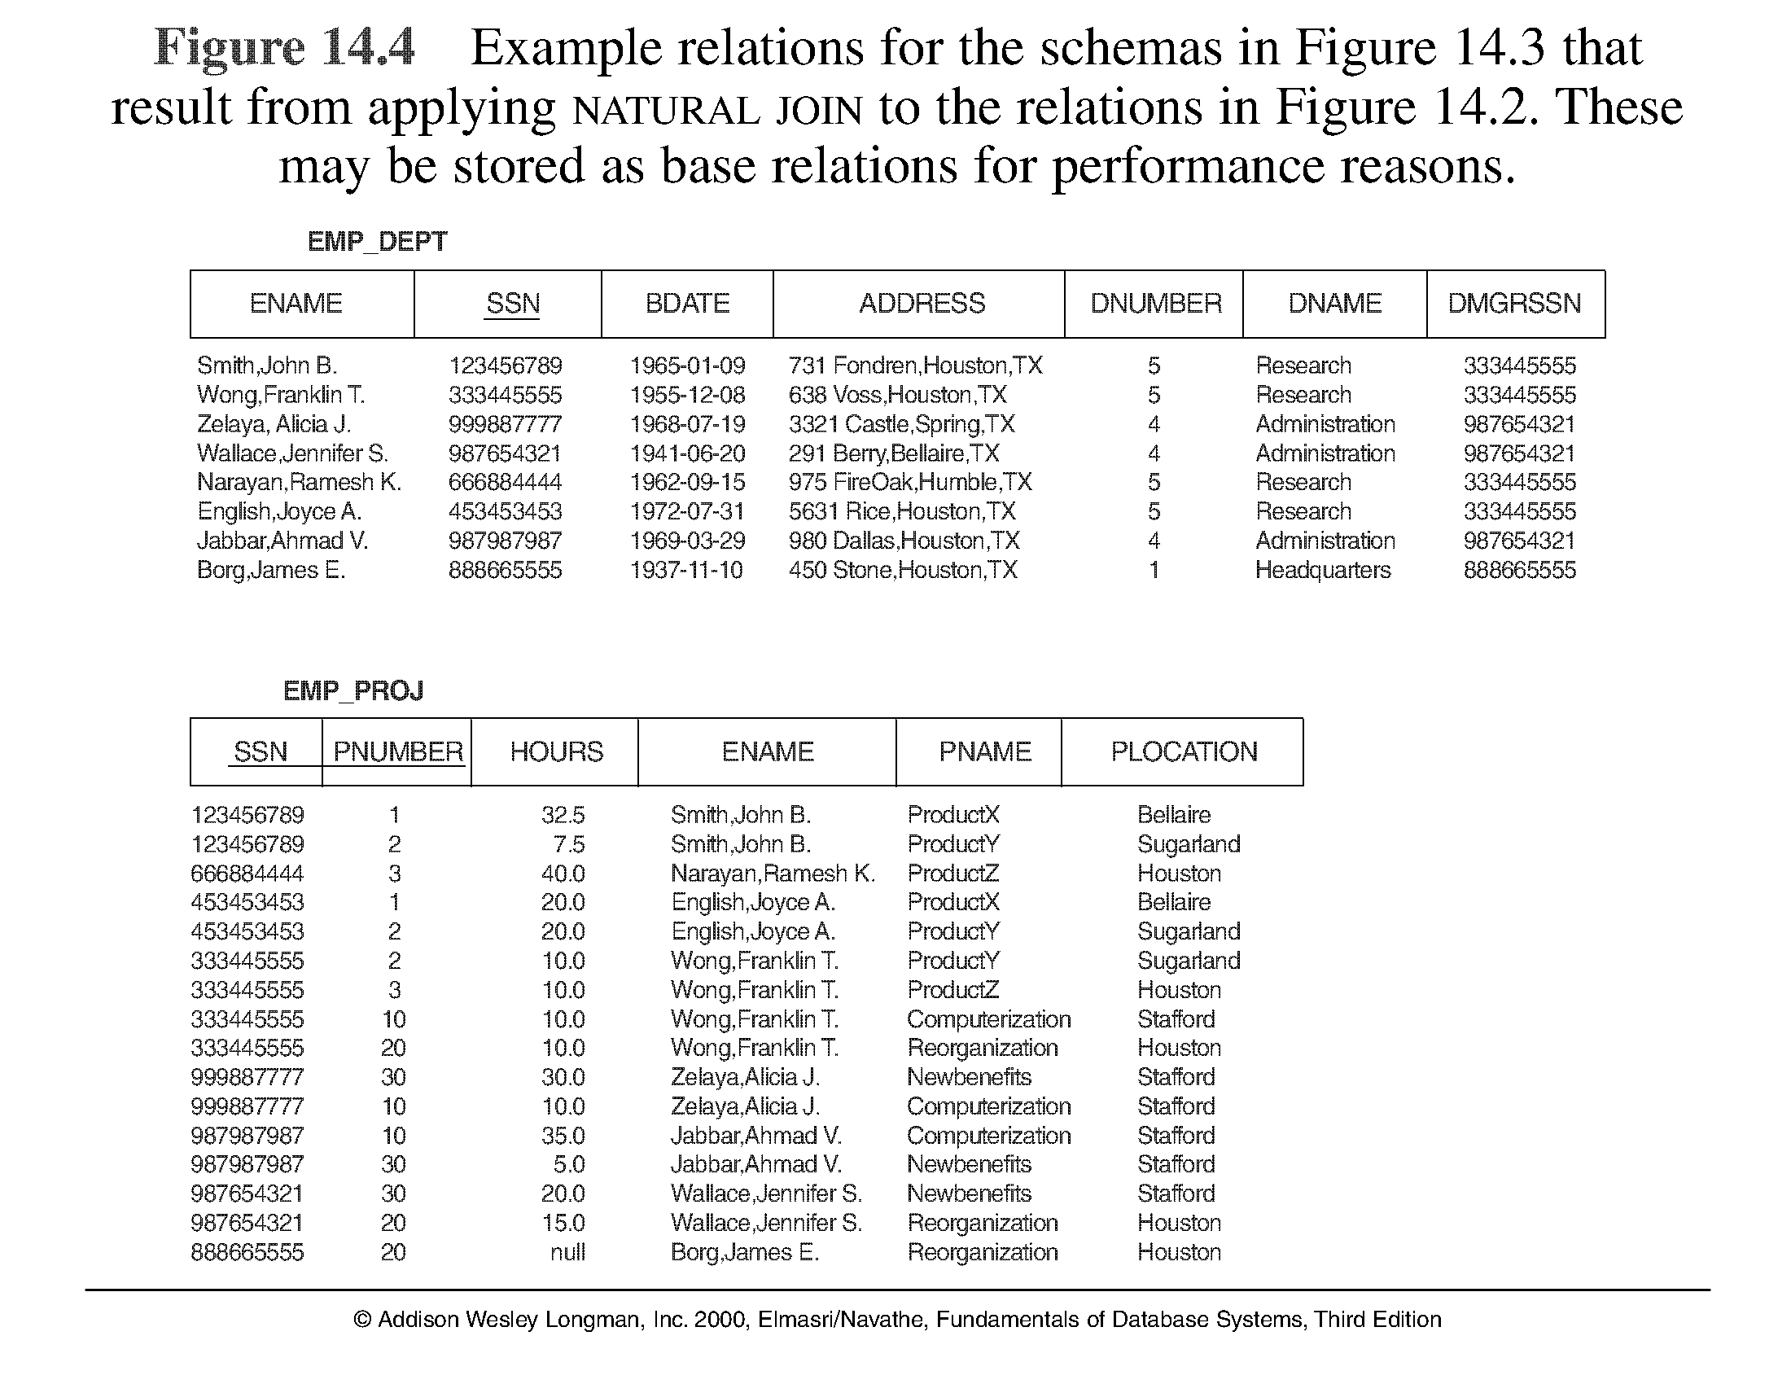
Figure 10.4 Example States for EMP_DEPT and EMP_PROJ

Slide 13
Guideline to Redundant Information in Tuples and Update Anomalies
GUIDELINE 2: Design a schema that does not suffer from the insertion, deletion and update anomalies. If there are any present, then note them so that applications can be made to take them into account

Slide 14
1.3 Null Values in Tuples
GUIDELINE 3: Relations should be designed such that their tuples will have as few NULL values as possible
Attributes that are NULL frequently could be placed in separate relations (with the primary key)
Reasons for nulls:
  attribute not applicable or invalid
  attribute value unknown (may exist)
  value known to exist, but unavailable

Slide 15
1.4 Spurious Tuples
Bad designs for a relational database may result in erroneous results for certain JOIN operations
GUIDELINE 4: The relations should be joined with equality conditions on attributes that are (primary key, foreign key) pairs in a way that guarantees that no spurious tuples are generated by doing a natural-join of any relations.

Slide 16
2.1 Functional Dependencies (1)
Functional dependencies (FDs) are used to specify formal measures of the "goodness" of relational designs
FDs and keys are used to define normal forms for relations
FDs are constraints that are derived from the meaning and interrelationships of the data attributes
A set of attributes X functionally determines a set of attributes Y if the value of X determines a unique value for Y

Slide 17
Functional Dependencies (2)
X -> Y holds if whenever two tuples have the same value for X, they must have the same value for Y
For any two tuples t1 and t2 in any relation instance r(R): If t1[X]=t2[X], then t1[Y]=t2[Y]
X -> Y in R specifies a constraint on all relation instances r(R)
Written as X -> Y; can be displayed graphically on a relation schema as in Figures. ( denoted by the arrow: ).
FDs are derived from the real-world constraints on the attributes

Slide 18
Examples of FD constraints (1)
social security number determines employee name
SSN -> ENAME
project number determines project name and location
PNUMBER -> {PNAME, PLOCATION}
employee ssn and project number determines the hours per week that the employee works on the project
{SSN, PNUMBER} -> HOURS
Chapter 10-<number>

Slide 19
Examples of FD constraints (2)
An FD is a property of the attributes in the schema R
The constraint must hold on every relation instance r(R)
If K is a key of R, then K functionally determines all attributes in R (since we never have two distinct tuples with t1[K]=t2[K])
Chapter 10-<number>

Slide 20
Inference Rules for Functional Dependencies (1/7)
We denote by F the set of functional dependencies that are specified on relation schema R.
An FD X → Y is inferred from a set of dependencies F specified on R if X → Y holds in every relation state r that is a legal extension of R; that is, whenever r satisfies all the dependencies in F, X → Y also holds in r.
The closure F⁺ of F is the set of all functional dependencies that can be inferred from F.
Chapter 10-<number>

Slide 21
Inference Rules for Functional Dependencies (2/7)
IR1 (reflexive rule): If X ⊇ Y, then X → Y.
IR2 (augmentation rule): {X → Y } ⇒ XZ → YZ.
IR3 (transitive rule): {X → Y, Y → Z} ⇒ X → Z.
IR4 (decomposition, or projective, rule): {X → YZ} ⇒ X → Y.
IR5 (union, or additive, rule): {X → Y, X → Z} ⇒ X → YZ.
IR6 (pseudotransitive rule): {X → Y, WY → Z } ⇒ WX → Z.
Chapter 10-<number>

Slide 22
Inference Rules for Functional Dependencies (3/7)
It has been shown by Armstrong (1974) that inference rules IR1 through IR3 are sound and complete.
Chapter 10-<number>

Slide 23
Inference Rules for Functional Dependencies (4/7)
Typically, database designers first specify the set of functional dependencies F that can easily be determined from the semantics of the attributes of R; then IR1, IR2, and IR3 are used to infer additional functional dependencies that will also hold on R.
Chapter 10-<number>

Slide 24
Inference Rules for Functional Dependencies (5/7)
A systematic way to determine these additional functional dependencies is first to determine each set of attributes X that appears as a left-hand side of some functional dependency in F and then to determine the set of all attributes that are dependent on X.
Thus for each such set of attributes X, we determine the set X⁺ of attributes that are functionally determined by X based on F; X⁺ is called the closure of X under F.
Chapter 10-<number>

Slide 25
Inference Rules for Functional Dependencies (6/7)
Algorithm 10.1 Determining X⁺, the closure of X under F
X⁺ := X;
repeat
old X⁺ := X⁺;
for each functional dependency Y → Z in F do
if X⁺ ⊇ Y then X⁺ := X⁺ ∪ Z;
until (X⁺ = old X⁺);
Chapter 10-<number>

Slide 26
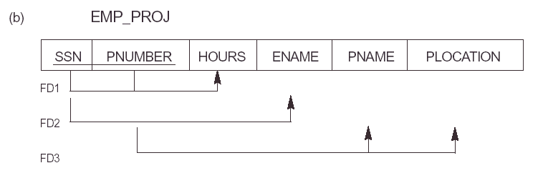
Chapter 10-<number>

Slide 27
Inference Rules for Functional Dependencies (7/7)
F = {SSN → ENAME,
PNUMBER → {PNAME, PLOCATION},
{SSN, PNUMBER} → HOURS}
Using Algorithm 10.1, we calculate the following closure sets with respect to F:
{ SSN }⁺ = { SSN, ENAME }
{ PNUMBER }⁺ = { PNUMBER, PNAME, PLOCATION }
{ SSN, PNUMBER }⁺ = { SSN, PNUMBER, ENAME, PNAME, PLOCATION, HOURS }
Chapter 10-<number>

Slide 28
Equivalence of Sets of Functional Dependencies (1/4)
A set of functional dependencies E is covered by a set of functional dependencies F—or alternatively, F is said to cover E—if every FD in E is also in F⁺; that is, if every dependency in E can be inferred from F.
Chapter 10-<number>

Slide 29
Equivalence of Sets of Functional Dependencies (2/4)
Two sets of functional dependencies E and F are equivalent if E⁺ = F⁺.
Hence, equivalence means that every FD in E can be inferred from F, and every FD in F can be inferred from E; that is, E is equivalent to F if both the conditions E covers F and F covers E hold.
Chapter 10-<number>

Slide 30
Equivalence of Sets of Functional Dependencies (3/4)
We can determine whether F covers E by calculating X⁺ with respect to F for each FD X → Y in E, and then checking whether this X⁺ includes the attributes in Y.
If this is the case for every FD in E, then F covers E.
Chapter 10-<number>

Slide 31
Equivalence of Sets of Functional Dependencies (4/4)
We determine whether E and F are equivalent by checking that E covers F and F covers E.
Chapter 10-<number>

Slide 32
Minimal Sets of Functional Dependencies (1/3)
A set of functional dependencies F is minimal if it satisfies the following conditions:
  Every dependency in F has a single attribute for its right-hand side.
  We cannot replace any dependency X → A in F with a dependency Y → A, where Y is a proper subset of X, and still have a set of dependencies that is equivalent to F.
  We cannot remove any dependency from F and still have a set of dependencies that is equivalent to F.
Chapter 10-<number>

Slide 33
Minimal Sets of Functional Dependencies (2/3)
A minimal cover of a set of functional dependencies F is a minimal set of dependencies F_{min} that is equivalent to F.
Unfortunately, there can be several minimal covers for a set of functional dependencies.
Chapter 10-<number>

Slide 34
Minimal Sets of Functional Dependencies (3/3)
Algorithm 10.2 Finding a minimal cover G for F
  Set G := F.
  Replace each functional dependency X →{A₁, A₂, …, A_{n}} in G by the n functional dependencies X → A₁, X → A₂, . . ., X → A_{n}.
  For each functional dependency X → A in G
  for each attribute B that is an element of X
  if ((G - {X → A}) ∪ {(X - {B}) → A}) is equivalent to G,
  then replace X → A with (X - {B}) → A in G.
  For each remaining functional dependency X → A in G
  if (G - {X → A}) is equivalent to G,
  then remove X → A from G.
Chapter 10-<number>

Slide 35

Chapter 10-<number>

Slide 36
Introduction to Normalization (1/5)
Normalization of data is a process of analyzing the given relation schemas based on their FDs and primary keys to achieve the desirable properties of (1) minimizing redundancy and (2) minimizing the insertion, deletion, and update anomalies.
Unsatisfactory relation schemas that do not meet certain conditions—the normal form tests—are decomposed into smaller relation schemas that meet the tests and hence possess the desirable properties.

Slide 37
Introduction to Normalization (2/5)
Normal forms, when considered in isolation from other factors, do not guarantee a good database design.
It is generally not sufficient to check separately that each relation schema in the database is, say, in BCNF or 3NF.
Chapter 10-<number>

Slide 38
Introduction to Normalization (3/5)
The process of normalization through decomposition must also confirm the existence of additional properties that the relational schemas, taken together, should possess.
These would include two properties:
  The lossless join or nonadditive join property
  The dependency preservation property
Chapter 10-<number>

Slide 39
Introduction to Normalization (4/5)
Database design as practiced in industry today pays particular attention to normalization up to BCNF or 4NF.
The database designers need not normalize to the highest possible normal form.
  The process of storing the join of higher normal form relations as a base relation—which is in a lower normal form—is known as denormalization.
Chapter 10-<number>

Slide 40
Introduction to Normalization (5/5)
An attribute of relation schema R is called a prime attribute of R if it is a member of some candidate key of R.
An attribute is called nonprime if it is not a prime attribute—that is, if it is not a member of any candidate key.
Chapter 10-<number>

Slide 41
First Normal Form
First normal form (1NF) states that the domain of an attribute must include only atomic (simple, indivisible) values and that the value of any attribute in a tuple must be a single value from the domain of that attribute.
Chapter 10-<number>

Slide 42
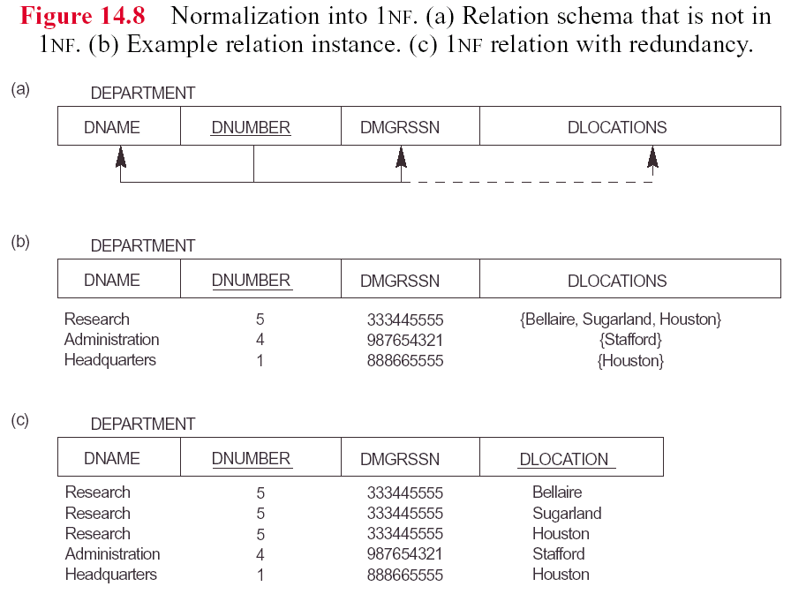
Chapter 10-<number>

Slide 43
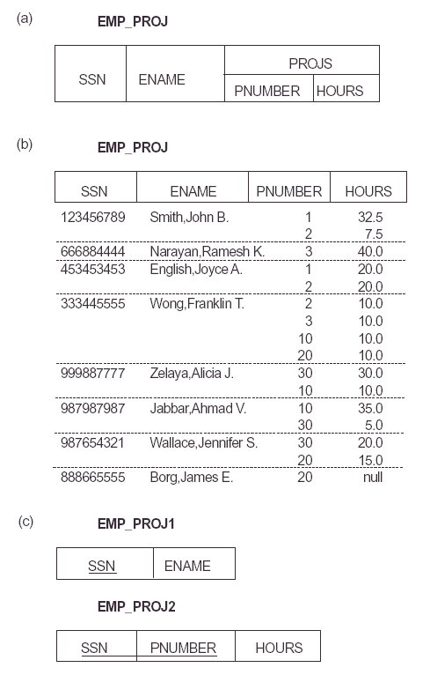
Chapter 10-<number>

Slide 44
Second Normal Form (1/2)
A functional dependency X → Y is a full functional dependency if removal of any attribute A from X means that the dependency does not hold any more; that is, for any attribute A ∈ X, (X - {A}) does not functionally determine Y.
A functional dependency X → Y is a partial dependency if some attribute A ∈ X can be removed from X and the dependency still holds; that is, for some A ∈ X, (X - {A}) → Y.
Chapter 10-<number>

Slide 45
Second Normal Form (2/2)
A relation schema R is in 2NF if every nonprime attribute A in R is fully functionally dependent on the primary key of R.
Chapter 10-<number>

Slide 46
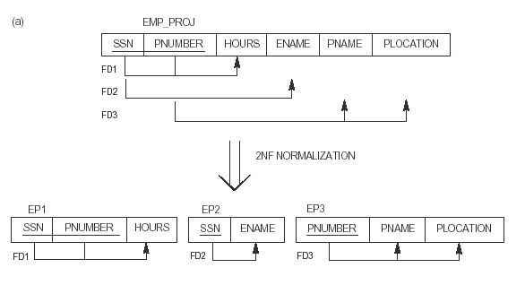
Chapter 10-<number>

Slide 47
Third Normal Form (1/2)
A functional dependency X → Y in a relation schema R is a transitive dependency if there is a set of attributes Z that is neither a candidate key nor a subset of any key of R, and both X → Z and Z → Y hold.
Chapter 10-<number>

Slide 48
Third Normal Form (2/2)
A relation schema R is in 3NF if it satisfies 2NF and no nonprime attribute of R is transitively dependent on the primary key.
Chapter 10-<number>

Slide 49
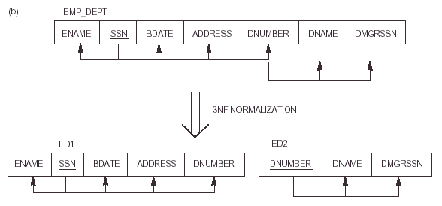
Chapter 10-<number>

Slide 50

Chapter 10-<number>

Slide 51
General Definition of Second Normal Form
A relation schema R is in second normal form (2NF) if every nonprime attribute A in R is not partially dependent on any key of R.
Chapter 10-<number>

Slide 52
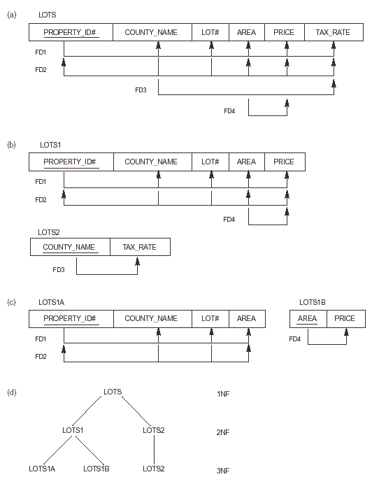
Chapter 10-<number>

Slide 53
General Definition of Third Normal Form
A relation schema R is in third normal form (3NF) if, whenever a nontrivial functional dependency X → A holds in R, either (a) X is a superkey of R, or (b) A is a prime attribute of R.
Chapter 10-<number>

Slide 54
Chapter 10-<number>

Slide 55
Boyce-Codd Normal Form
A relation schema R is in BCNF if whenever a nontrivial functional dependency X → A holds in R, then X is a superkey of R.
Chapter 10-<number>

Slide 56
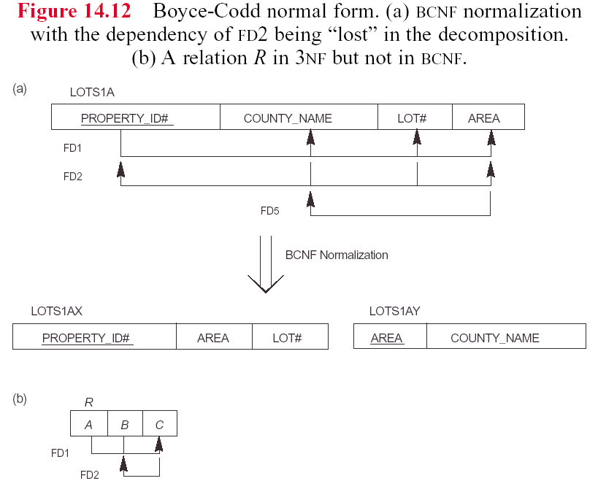
Chapter 10-<number>

Slide 57
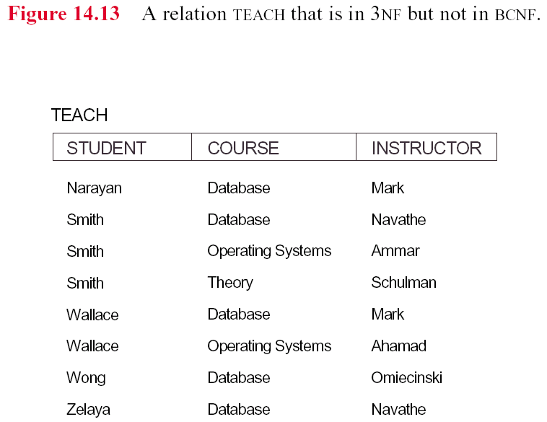
Chapter 10-<number>

Slide 58
Achieving the BCNF by Decomposition (1)
Two FDs exist in the relation TEACH:
fd1: { student, course} -> instructor
fd2: instructor -> course
{student, course} is a candidate key for this relation and that the dependencies shown follow the pattern in Figure 10.12 (b). So this relation is in 3NF but not in BCNF
A relation NOT in BCNF should be decomposed so as to meet this property, while possibly forgoing the preservation of all functional dependencies in the decomposed relations. (See Algorithm 11.3)
Chapter 10-<number>

Slide 59
Achieving the BCNF by Decomposition (2)
Three possible decompositions for relation TEACH
  {student, instructor} and {student, course}
  {course, instructor } and {course, student}
  {instructor, course } and {instructor, student}
All three decompositions will lose fd1. We have to settle for sacrificing the functional dependency preservation. But we cannot sacrifice the non-additivity property after decomposition.
Out of the above three, only the 3rd decomposition will not generate spurious tuples after join.(and hence has the non-additivity property).
A test to determine whether a binary decomposition (decomposition into two relations) is nonadditive (lossless) is discussed in section 11.1.4 under Property LJ1. Verify that the third decomposition above meets the property.
Chapter 10-<number>

